Slide 1

UNIT - 1
BASICS OF PHP

Slide 2
What is PHP?
PHP is an acronym for "PHP: Hypertext Preprocessor“.
PHP is a widely-used, open source scripting language
PHP scripts are executed on the server
PHP is free to download and use.
PHP files can contain text, HTML, CSS, JavaScript, and PHP code
PHP code is executed on the server, and the result is returned to the browser as plain HTML
PHP files have extension ".php"

Slide 3
What Can PHP Do?
PHP can generate dynamic page content
PHP can create, open, read, write, delete, and close files on the server
PHP can collect form data
PHP can send and receive cookies/sessions
PHP can add, delete, modify data in your database
PHP can be used to control user-access
PHP can encrypt data

Slide 4
HISTORY OF PHP
PHP was conceived sometime in the fall of 1994 by Rasmus Lerdorf.
Early non-released versions were used on his home page to keep track of who was looking at his online resume.
The first version used by others was available sometime in early 1995 and was known as the Personal Home Page Tools.
Features
Simple
Flexible
Platform independent
Interpreted
Fast and open source
Secure and more community

Slide 5
Set Up PHP on Your Own PC
To run PHP code, you need the following three software on your local machine:
Web Server (e.g., Apache)
PHP (Interpreter)
MySQL Databases (optional)
You can separately install Web Server, PHP Interpreter, and MySQL databases, but to make work easier, developers have made all in one setup packages called WAMP, LAMP, MAMP, and XAMPP, which will automatically install and set up PHP environment on your Windows, Linux or MAC machines.
The official PHP website (PHP.net) has installation instructions for PHP: http://php.net/manual/en/install.php

Slide 6
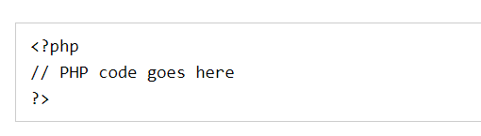
Basic PHP Syntax
A PHP script can be placed anywhere in the document.
A PHP script starts with <?php and ends with ?>:
The default file extension for PHP files is ".php".
A PHP file normally contains HTML tags, and some PHP scripting code.

Slide 7
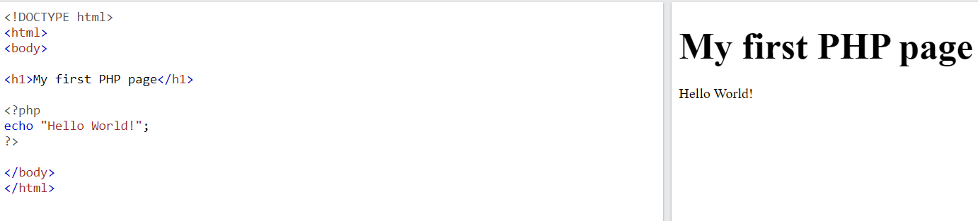
PHP statements end with a semicolon (;).

Slide 8
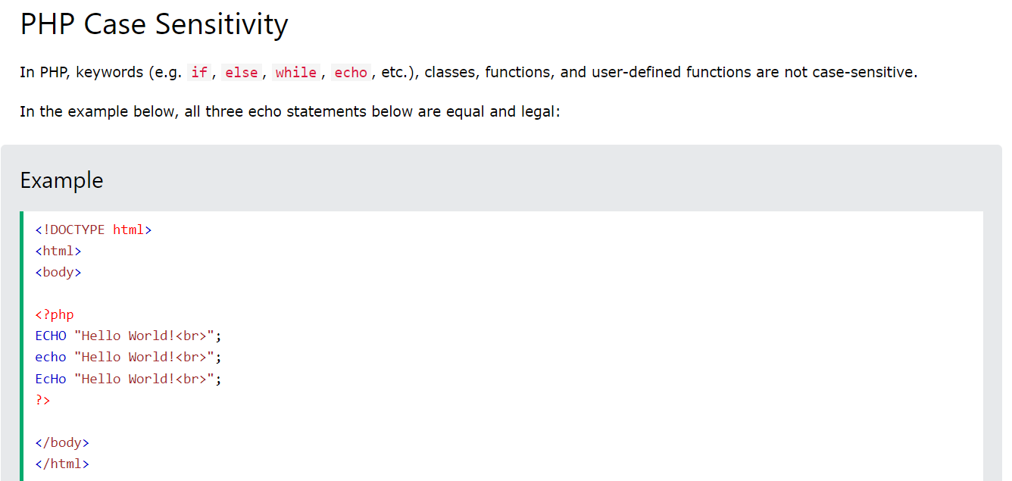

Slide 9
PHP echo and print Statements
With PHP, there are two basic ways to get output: echo and print.
PHP echo and print Statements
echo and print are more or less the same. They are both used to output data to the screen.
The differences are small: echo has no return value while print has a return value of 1 so it can be used in expressions. echo can take multiple parameters (although such usage is rare) while print can take one argument. echo is marginally faster than print.

Slide 10
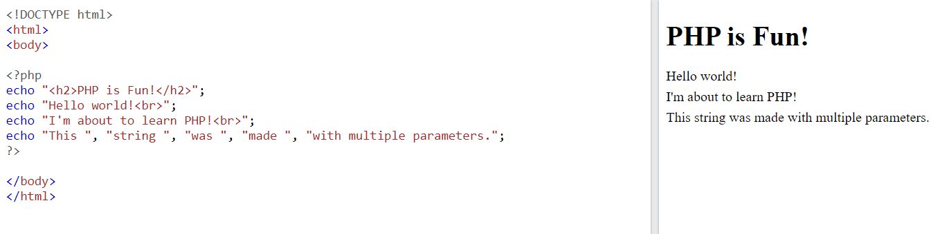
The PHP echo Statement
The echo statement can be used with or without parentheses: echo or echo().

Slide 11
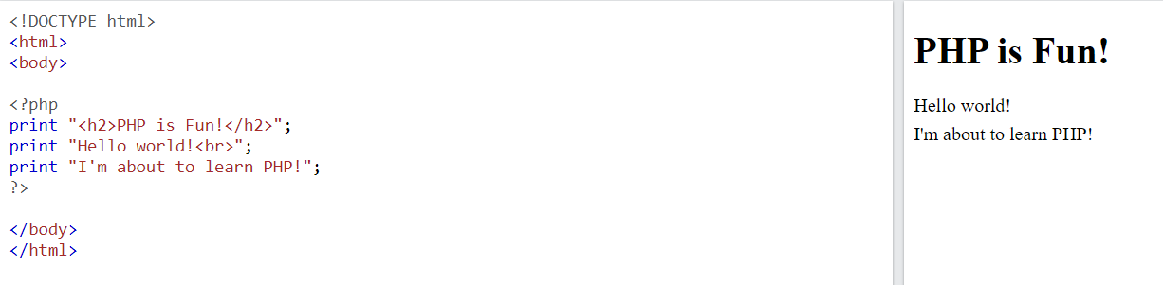
The PHP print Statement
The print statement can be used with or without parentheses: print or print().

Slide 12
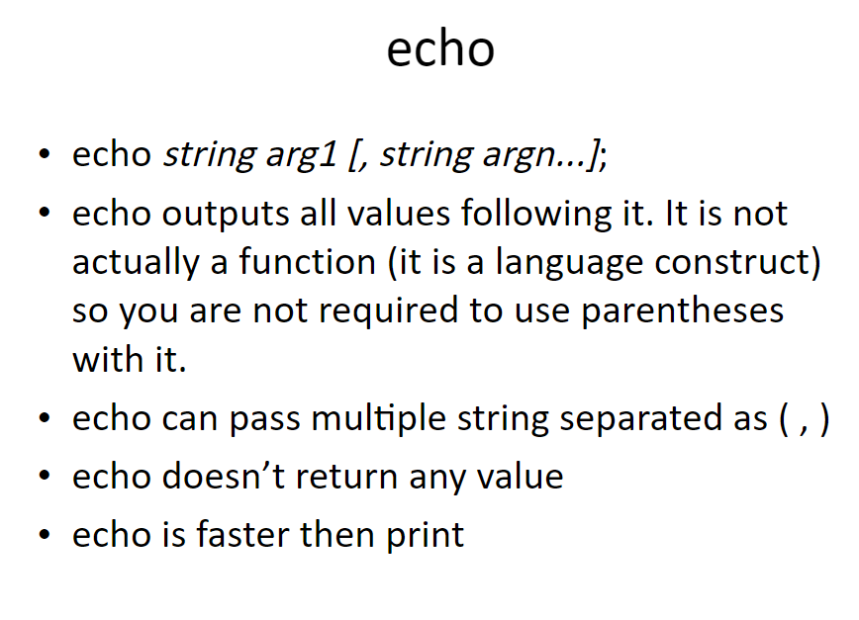

Slide 13
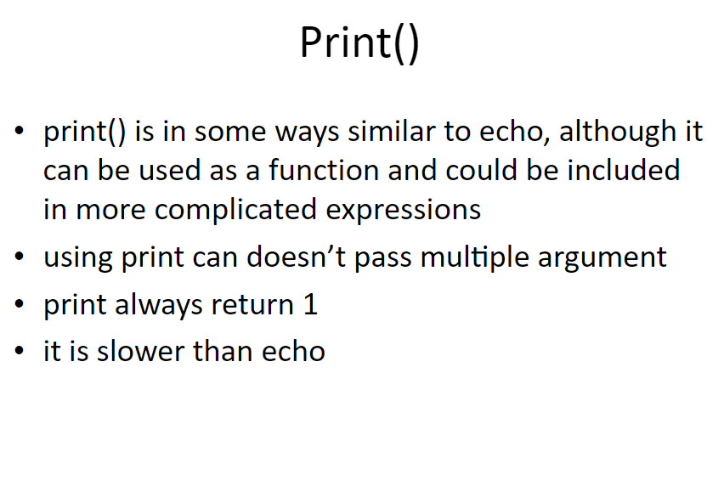

Slide 14
PHP Variables
A variable can have a short name (like x and y) or a more descriptive name (age, carname, total_volume).
Rules for PHP variables:
A variable starts with the $ sign, followed by the name of the variable
A variable name must start with a letter or the underscore character
A variable name cannot start with a number
A variable name can only contain alpha-numeric characters and underscores (A-z, 0-9, and _ )
Variable names are case-sensitive ($age and $AGE are two different variables)

Slide 15
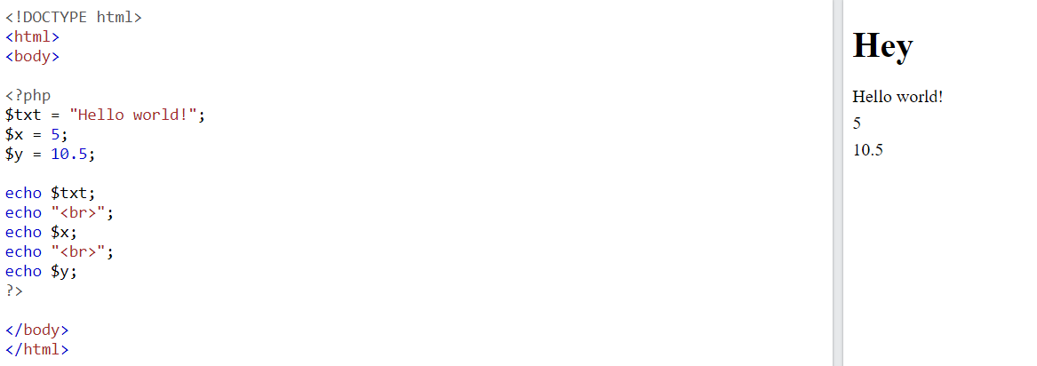
Variables are "containers" for storing information.
Remember that PHP variable names are case-sensitive!

Slide 16
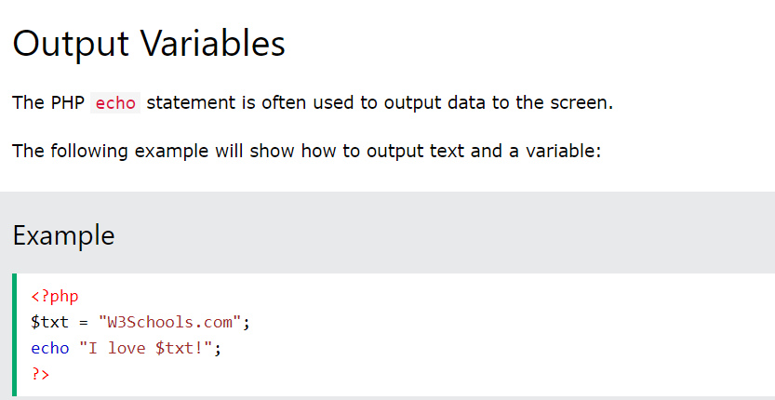

Slide 17
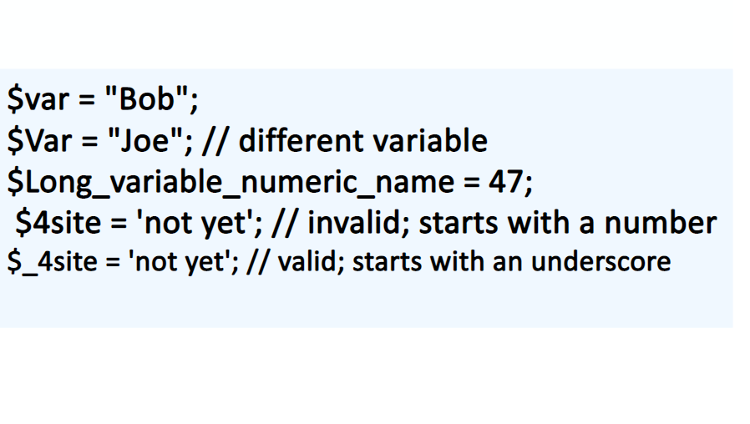

Slide 18
PHP Variables Scope
In PHP, variables can be declared anywhere in the script.
The scope of a variable is the part of the script where the variable can be referenced/used.
PHP has three different variable scopes:
local
global
static

Slide 19
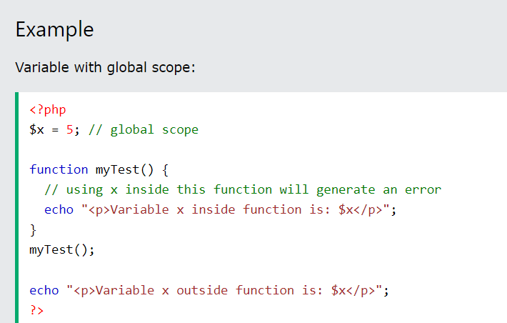
Global and Local Scope
A variable declared outside a function has a GLOBAL SCOPE and can only be accessed outside a function:

Slide 20
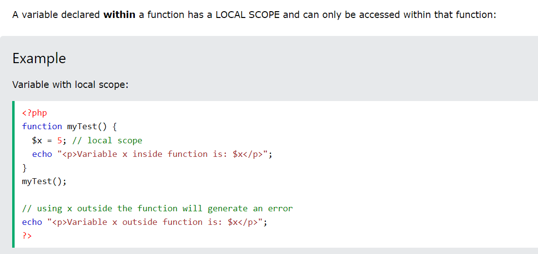

Slide 21
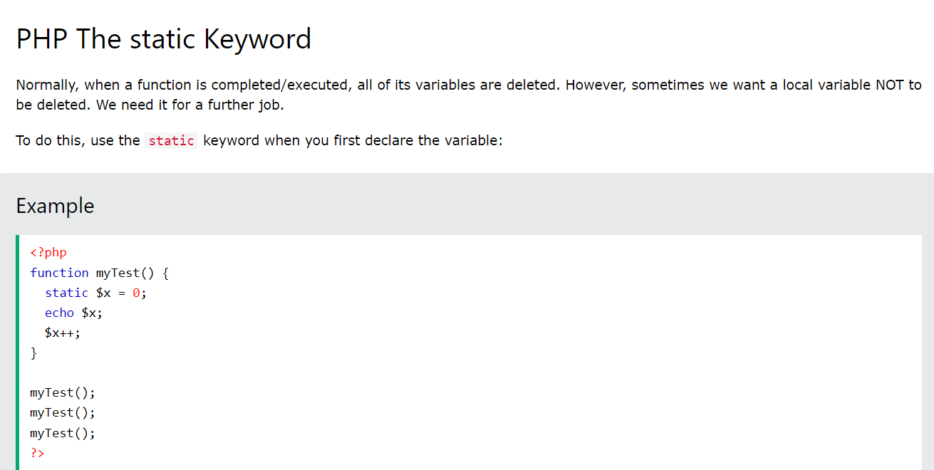

Slide 22
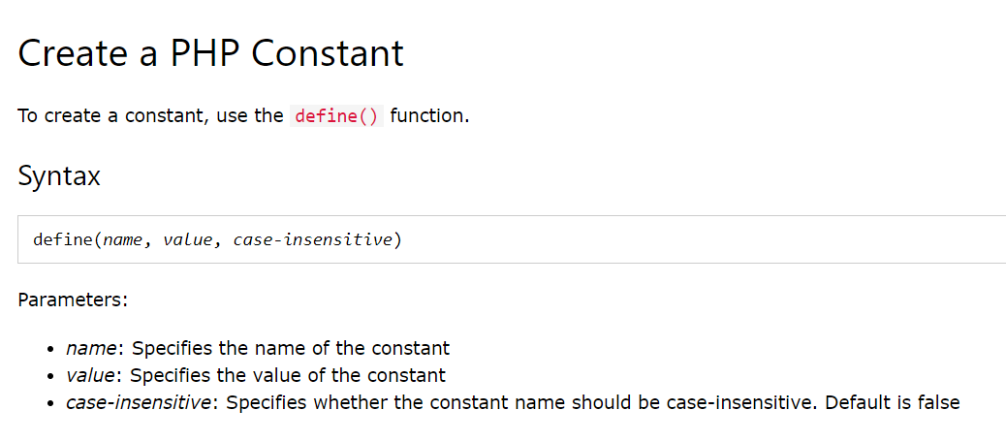
PHP Constants
A constant is an identifier (name) for a simple value. The value cannot be changed during the script.
A valid constant name starts with a letter or underscore (no $ sign before the constant name).

Slide 23
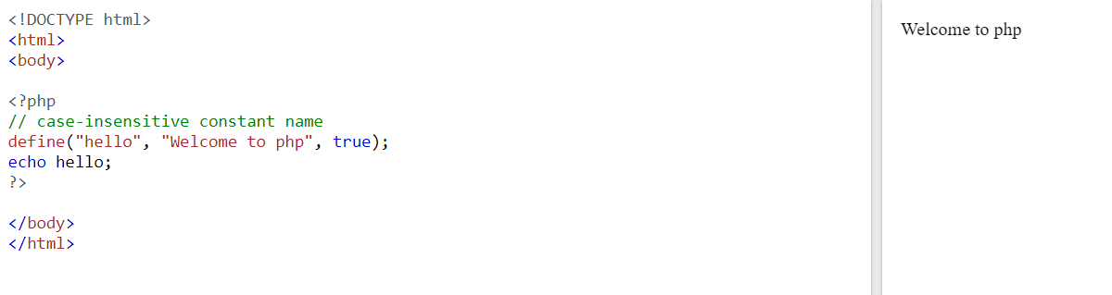
PHP Constants

Slide 24
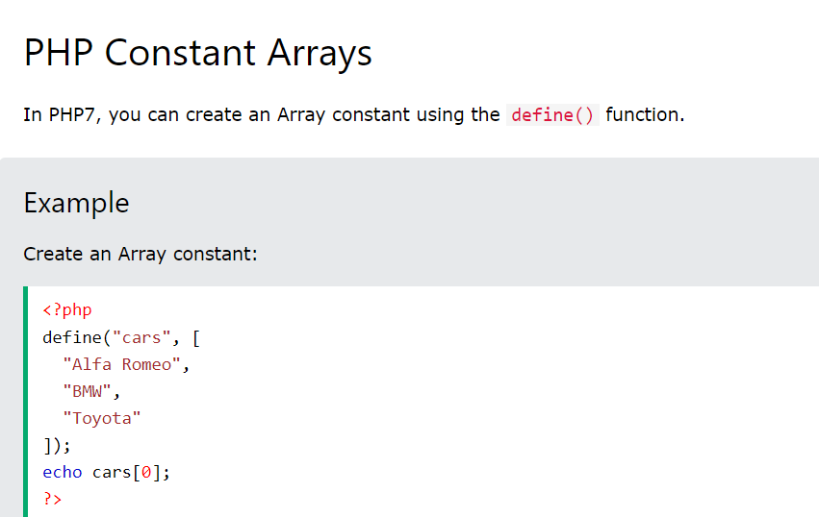


Slide 25
Arithmetic & Assignment Operators
+ | Addition | $x + $y
- | Subtraction | $x - $y
* | Multiplication | $x * $y
/ | Division | $x / $y
% | Modulus | $x % $y
** | Exponentiation | $x ** $y
Assignment | Same as...
x = y | x = y
x += y | x = x + y
x -= y | x = x - y
x *= y | x = x * y
x /= y | x = x / y
x %= y | x = x % y

Slide 26
Comparison, logical operator
Operator | Name | Example
== | Equal | $x == $y
=== | Identical | $x === $y
!= | Not equal | $x != $y
<> | Not equal | $x <> $y
!== | Not identical | $x !== $y
> | Greater than | $x > $y
< | Less than | $x < $y
>= | Greater than or equal to | $x >= $y
<= | Less than or equal to | $x <= $y
and | And | $x and $y
or | Or | $x or $y
xor | Xor | $x xor $y
&& | And | $x && $y
|| | Or | $x || $y
! | Not | !$x
++$x | Pre-increment
$x++ | Post-increment
--$x | Pre-decrement
$x-- | Post-decrement

Slide 27
. | Concatenation | $txt1 . $txt2
.= | Concatenation assignment | $txt1 .= $txt2
?: | Ternary | $x = expr1 ? expr2 : expr3

Slide 28
Difference between Server Side Scripting and Client Side Scripting
Client-side Scripting
It helps work with the front end.
It is visible to the users.
The scripts are run on the client browser.
It runs on the user/client’s computer.
It depends on the browser’s version.
It doesn’t interact with the server to process data.
Client side scripting involves languages such as HTML, CSS, JavaScript.
It helps reduce the load on the server.
It is considered to be less secure in comparison to client side scripting.

Slide 29
Difference between Server Side Scripting and Client Side Scripting
Server-side Scripting
It helps work with the back end.
It doesn’t depend on the client.
It runs on the web server.
It helps provide a response to every request that comes in from the user/client.
This is not visible to the client side of the application.
It requires the interaction with the server for the data to be process.
Server side scripting requires languages such as PHP, ASP.net, ColdFusion, Python, Ruby on Rails.
It is considered to be a secure way of working with applications.
It can be used to customize web pages.
It can also be used to provide dynamic websites.

Slide 30
PHP Loops
Loops are used to execute the same block of code again and again, as long as a certain condition is true
In PHP, we have the following loop types:
while - loops through a block of code as long as the specified condition is true
do...while - loops through a block of code once, and then repeats the loop as long as the specified condition is true
for - loops through a block of code a specified number of times
foreach - loops through a block of code for each element in an array

Slide 31
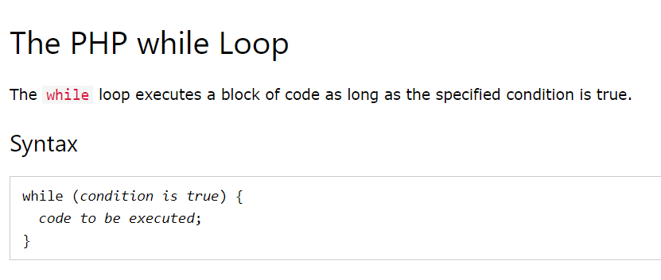
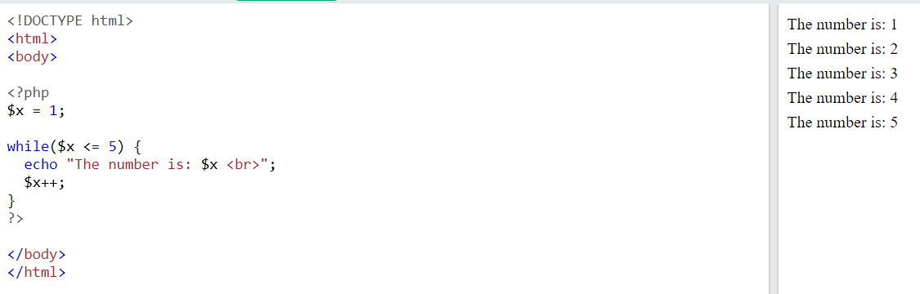

Slide 32
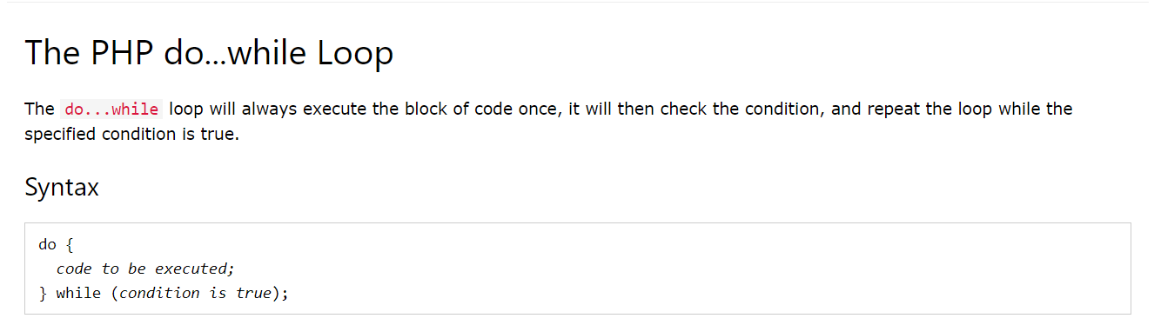

Slide 33
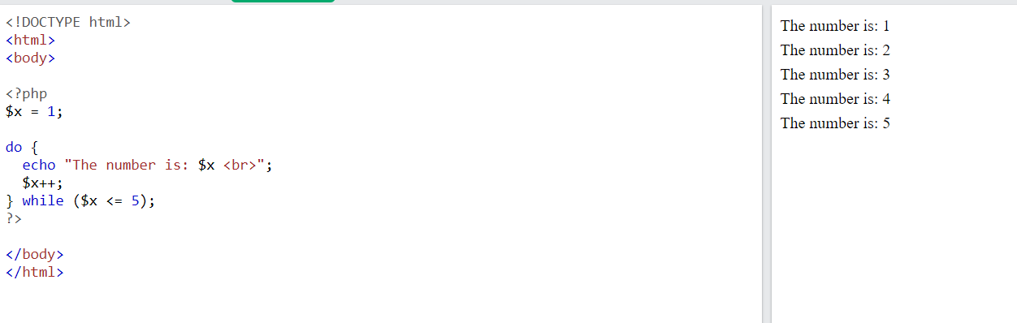

Slide 34
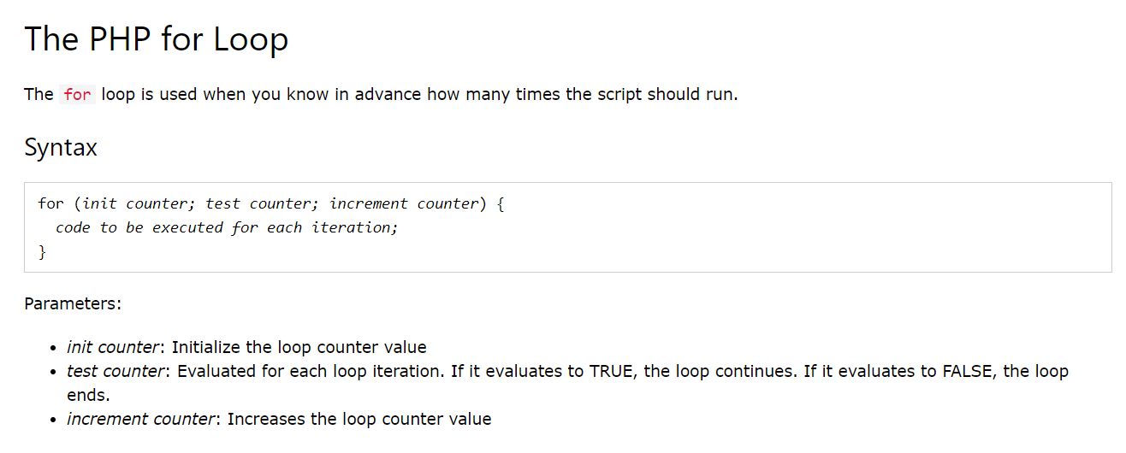

Slide 35
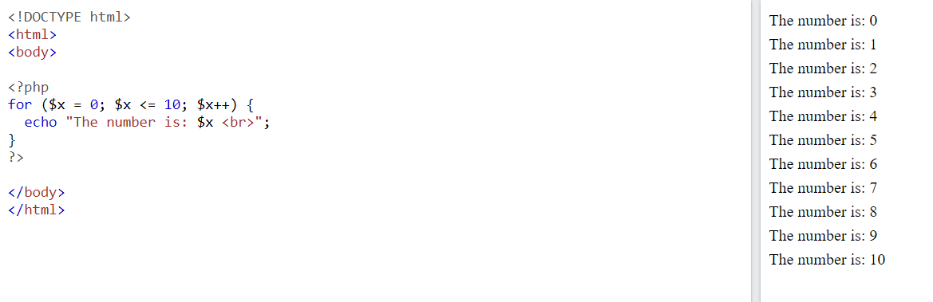

Slide 36
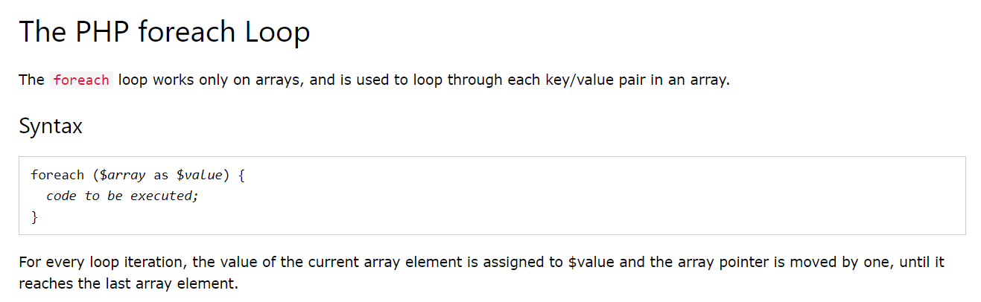

Slide 37
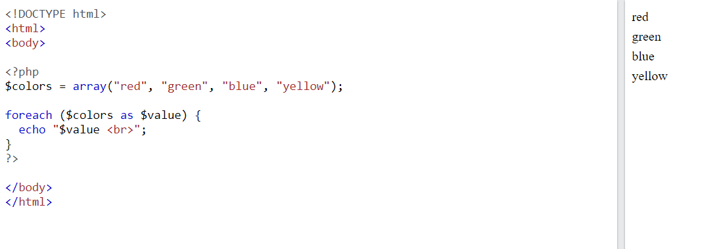

Slide 38
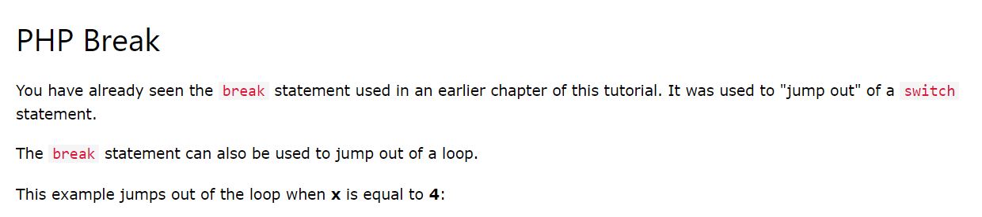
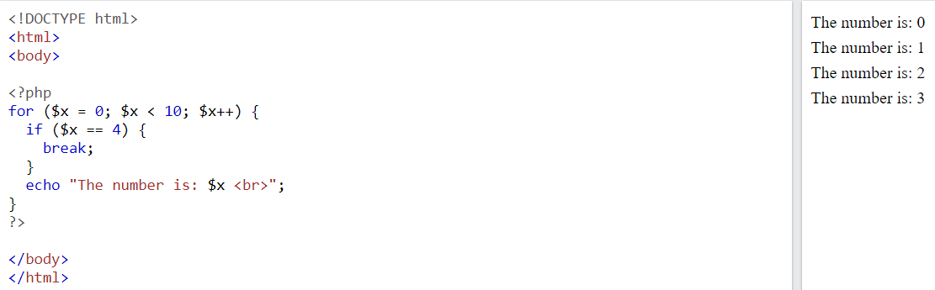
PHP Break and Continue

Slide 39
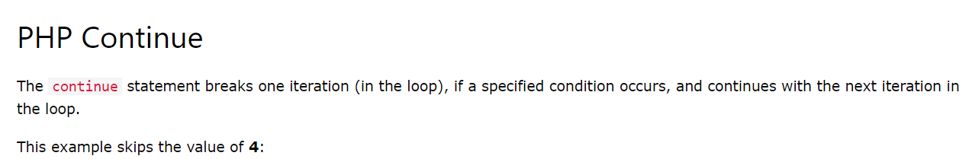
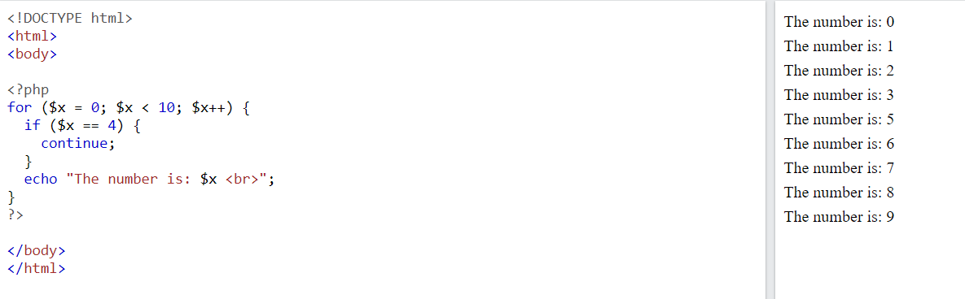

Slide 40
PHP Conditional Statements
Very often when you write code, you want to perform different actions for different conditions. You can use conditional statements in your code to do this.
In PHP we have the following conditional statements:
if statement - executes some code if one condition is true
if...else statement - executes some code if a condition is true and another code if that condition is false
if...elseif...else statement - executes different codes for more than two conditions
switch statement - selects one of many blocks of code to be executed

Slide 41
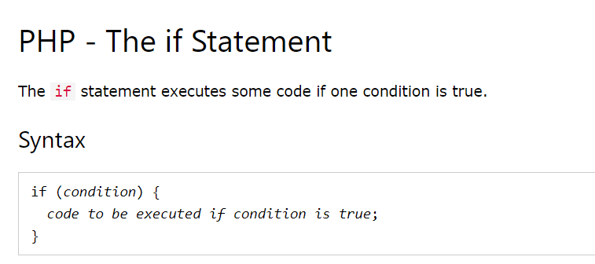
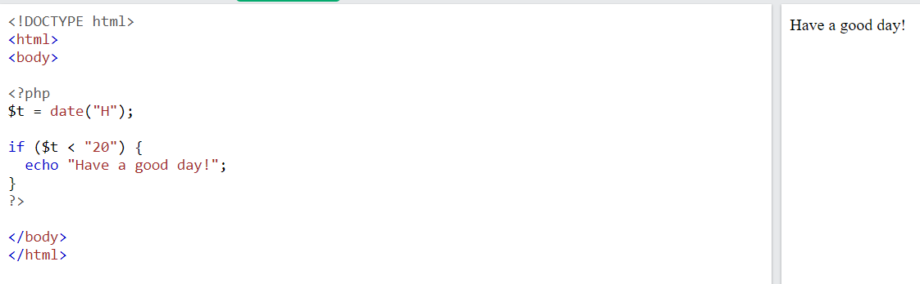

Slide 42
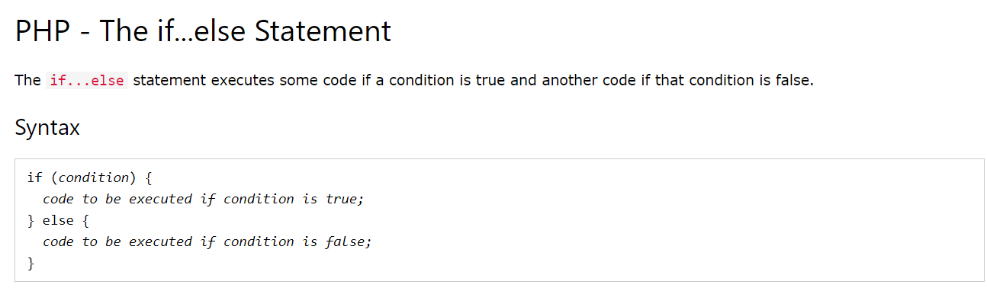
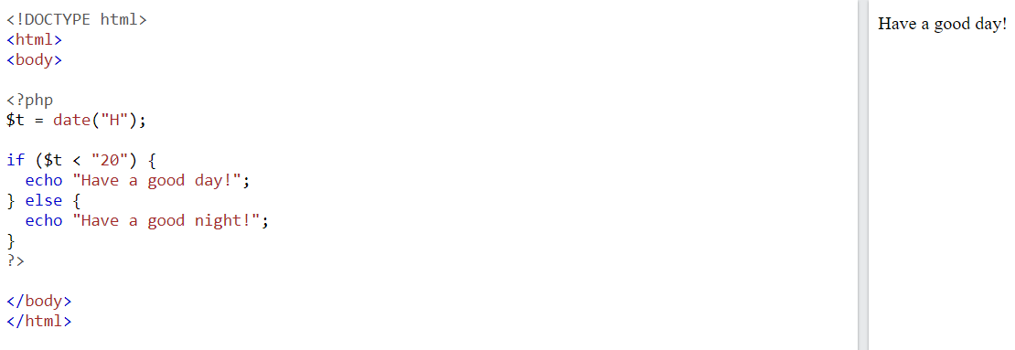

Slide 43
PHP - What is OOP?
❮
Object-Oriented programming is faster and easier to execute.
Procedural programming is about writing procedures or functions that perform operations on the data, while object-oriented programming is about creating objects that contain both data and functions.
Object-oriented programming has several advantages over procedural programming:
OOP is faster and easier to execute
OOP provides a clear structure for the programs
OOP helps to keep the PHP code DRY "Don't Repeat Yourself", and makes the code easier to maintain, modify and debug
OOP makes it possible to create full reusable applications with less code and shorter development time

Slide 44
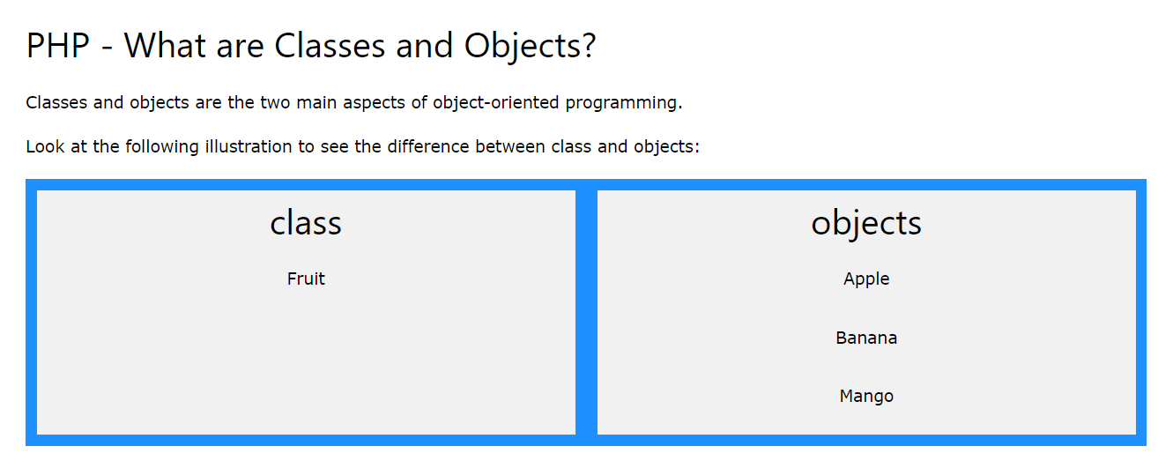

Slide 45
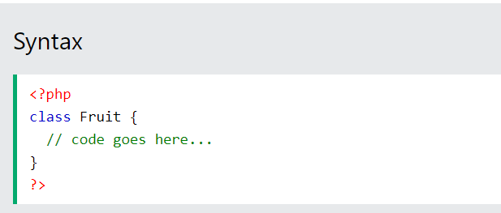
Define a Class
A class is defined by using the class keyword, followed by the name of the class and a pair of curly braces ({}). All its properties and methods go inside the braces:

Slide 46
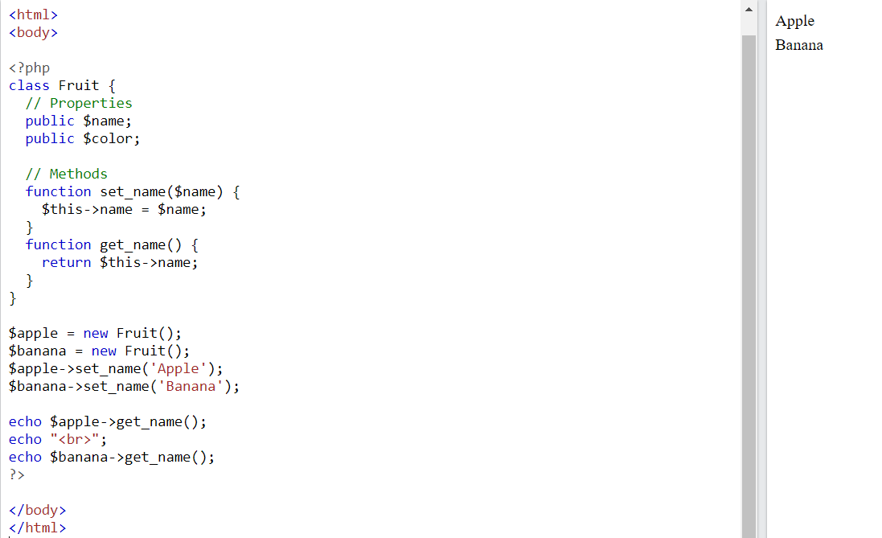
Define Objects
Classes are nothing without objects! We can create multiple objects from a class. Each object has all the properties and methods defined in the class, but they will have different property values.
Objects of a class are created using the new keyword.

Slide 47
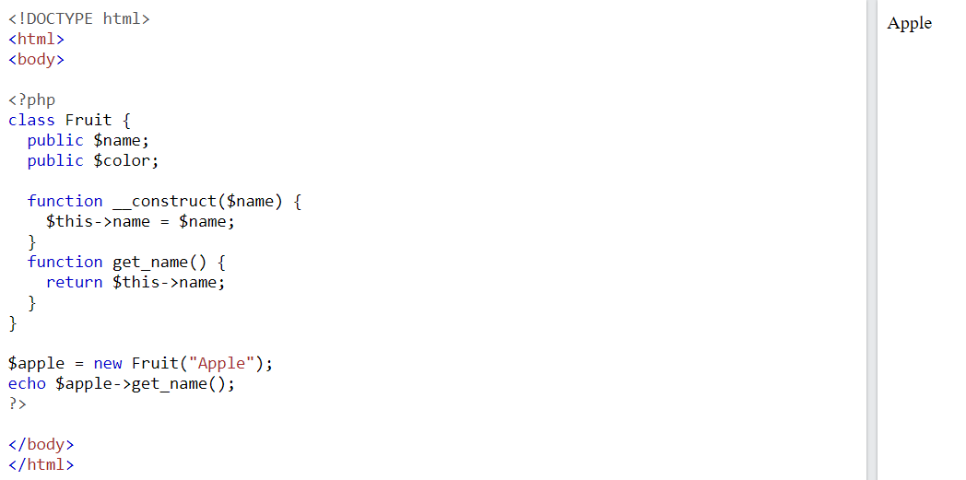
PHP - The __construct Function
A constructor allows you to initialize an object's properties upon creation of the object.
If you create a __construct() function, PHP will automatically call this function when you create an object from a class.
Notice that the construct function starts with two underscores (__)!

